Slide 1
Natural Language Processing Textual Data Handling - ScikitLearn

Slide 2
Course outline
Discuss textual data and their characteristics - sklearn
Use Python modules to clean textual data
Use Python modules to parse and clean HTML documents
Use Python modules to remove punctuation and stopwords
Use Python modules for textual data tokenization
Discuss the process of text mining and stemming
Discuss and use Python modules to encode textual data as bag of words
Discuss the concept of TF/IDF scoring in Python

Slide 3

Contents
Textual Data
Cleaning Textual Data
Word Tokenization
Removal of Stop Words
Stemming
Parsing and cleaning HTML data
Bag of Words
TF/IDF

Slide 4
Textual Data
Generally we work on many textual datasets which are either in csv or excel format with data split into attributes and fields in proper format. This is called Structured Textual data. While coming to Natural Language processing the textual data which we are talking about is unformatted data called unstructured data.
Data which we process using NLP applications generally contains words, text sentences, clauses, phrases and paragraphs. This data doesn’t have any proper structure to be parsed unlike structured data. Hence data cleaning, processing etc. are required to perform. Perfect example of the kind of textual data which we handle in NLP would be this slide, the content in this slide.

Slide 5
Problem with Text
The ultimate goal in any Natural Language Processing application is building a model on the textual data according to the business case and then use the model.
Machine Learning algorithms or any neural network algorithms generally work on numbers or vectors which are numeric representations.
Textual data needs preprocessing as its mostly unstructured and has much noise, hence data cleaning plays a major role in any NLP application.
Textual data is messy, as it has words and application of any machine learning algorithm on textual data directly is not possible. Hence the text must be converted into numbers, especially into vectors of numbers. This is called as Feature Extraction or Feature Encoding.

Slide 6
Cleaning Textual data
Removal of Stop Words:
Stop words are the words which are used most by humans and add less significance to the business use case in hand. Some examples of stop words are might, may, let, must, need, basically, yeah etc.
Stop words are removed as they are less significant and can be considered a preprocessing step. Either the stop words can be removed explicitly, or another vector space can be created to store the instances of stop words for more accurate business use cases.
Tokenization:
Tokens can be words, clauses, phrases or sentences which are part of an actual sentence
Textual data is divided into classified set of tokens which cause significant advantage to business use case.

Slide 7
Cleaning Textual data
Expanding Contractions:
Contractions are words such as I’ve, didn’t, we’ve, shouldn’t etc. These contractions are expanded into actual words as I have, did not, we have, should not correspondingly.
Stemming:
Stemming is a text pre-processing technique which reduces a word to its stem or root format.
Stemming algorithms are very simple and similar to search and replace operation.
Lemmatization:
It is a text pre-processing technique similar to stemming which reduces a word to its root format.
Lemmatization uses branching techniques and dictionary to map different variants of words to a base word called lemma.

Slide 8
Word Tokenization
Tokens can be words, clauses, phrases or sentences which are part of an actual sentence. Textual data is divided into classified set of tokens which cause significant advantage to business use case.
Generally, in NLP applications sentences are tokenized into words in order to analyze the words and count the occurrences of words etc. which are useful in further steps.
The next step generally after cleaning data using Cleaning techniques will be feature encoding or feature extraction where the textual data is converted into numerical vectors.

Slide 9
Word Tokenization
Scikit-learn often regarded in short as sklearn provides a class which tokenizes the text into words and return the stream of words called CountVectorizer.
CountVectorizer class provides two functionalities: tokenize the data into words and also build vocabulary on top of it. Vocabulary is nothing but the collection of all the unique words in the data with an index assigned to it.
CountVectorizer class has a method called build_tokenizer() which returns a function that can be used to tokenize the sentences into words.
Count Vectorizer can be imported as
from sklearn.feature_extraction.text import CountVectorizer

Slide 10
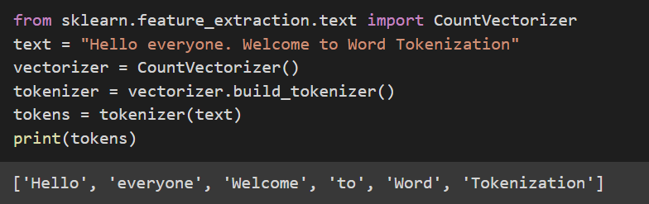
Word Tokenization
We can use CountVectorizer in scikit learn in the following way
Create an instance of CountVectorizer class
Invoke the build_tokenizer() method to generate a function to tokenize data
Use the tokenizer function generated to tokenize the data into words.

Slide 11
Stop Words
Stop words are the words which are used most by humans and add less significance to the business use case in hand. Some examples of stop words are might, may, let, must, need, basically, yeah etc.
Stop words are removed as they are less significant and can be considered a preprocessing step. Either the stop words can be removed explicitly, or another vector space can be created to store the instances of stop words for more accurate business use cases.

Slide 12
Removal of Stop Words
By looking at the word removal of stop words, the basic thought which we would get on how to remove stop words is by storing them in a list and removing all the occurrences of those words from text.
Sklearn.feature_extraction module in python provides the stop words in different languages.
We can simply import them as from sklearn.feature_extraction import _stop_words
We can exclude stop words by simply providing the stop words extracted from above syntax for the stop words parameter in the Count_vectorizer or any other feature extraction methods.

Slide 13
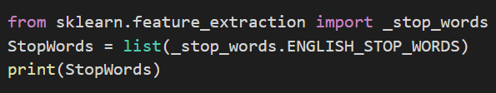
Removal of Stop Words
Let’s have a look at available stop words in sklearn
'themselves', 'i', 'at', 'sincere', 'except', 'whenever', 'fill', 'along', 'since', 'alone', 'ours', 'seeming', 'she', 'get', 'not', 'the', 'then', 'are', 'towards', 'beyond', 'nobody', 'side', 'thin', 'whence', 'besides', 'everything', 'four', 'up', 'become', 'thus', 'always', 'thru', 'co', 'me', 'of', 'onto', 'whose', 'mine', 'out', 'someone', 'once', 'himself', 'enough', 'were', 'latterly', 'beforehand', 'ourselves', 'nothing', 'has', 'otherwise', 'so', 'thence', 'empty', 'until', 'hasnt', 'hereafter', 'least', 'put', 'ten', 'to', 'indeed', 'only', 'those', 'seem', 'cannot', 'whither', 'therefore', 'had', 'is', 'first', 'anywhere', 'an', 'other', 'con', 'go', 'find', 'eg', 'less', 'next', 'am', 'third', 'interest', 'whereas', 'sixty', 'but', 'across', 'never', 'amount', 'whether', 'should', 'keep', 'and', 'because', 'you', 'everywhere', 'rather', 'down', 'wherein', 'such', 'again', 'beside', 'inc', 'twelve', 'hereupon', 'moreover', 'became', 'whole', 'already', 'front', 'show', 'do', 'was', 'being', 'below', 'than', 'many', 'describe', 'well', 'it', 'further', 'however', 'hers', 'ever', 'none', 'will', 'almost', 'might', 'anyhow', 'how', 'together', 'becoming', 'one', 'their', 'un', 'through', 'two', 'bottom', 'thereupon', 'without', 'wherever', 'why', 'who', 'nowhere', 'afterwards', 'see', 'somewhere', 'give', 'noone', 'after', 'often', 'these', 'throughout', 'eleven', 'neither', 'fifteen', 'thereby', 'whom', 'same', 'where', 'another', 'although', 'my', 'could', 'both', 'among', 'him', 'former', 'couldnt', 'whatever', 'three', 'there', 'its', 'every', 'whereupon', 'seemed', 'nor', 'hence', 'during', 'this', 'found', 'etc', 'via', 'sometimes', 'elsewhere', 'here', 'yet', 'ltd', 'even', 'our', 'something', 'twenty', 'by', 'under', 'more', 'all', 'six', 'anyway', 'though', 'amoungst', 'formerly', 'de', 'namely', 'move', 'own', 'have', 'a', 'seems', 'made', 'when', 'what', 'detail', 'five', 'that', 'still', 'last', 'else', 'bill', 'nine', 'must', 'would', 'much', 'amongst', 'her', 'from', 'now', 'your', 'into', 'also', 'somehow', 'cant', 'itself', 'herein', 'which', 'behind', 'some', 'yourself', 'back', 'few', 'system', 'his', 'forty', 'mill', 'been', 'fifty', 're', 'either', 'between', 'part', 'within', 'whereby', 'due', 'as', 'full', 'above', 'against', 'off', 'hundred', 'cry', 'we', 'sometime', 'around', 'yourselves', 'can', 'hereby', 'thereafter', 'he', 'may', 'whoever', 'latter', 'no', 'done', 'ie', 'per', 'name', 'most', 'if', 'take', 'for', 'therein', 'with', 'or', 'toward', 'too', 'yours', 'please', 'anything', 'thick', 'in', 'them', 'very', 'mostly', 'eight', 'serious', 'herself', 'each', 'meanwhile', 'anyone', 'be', 'before', 'myself', 'over', 'others', 'whereafter', 'several', 'while', 'fire', 'nevertheless', 'perhaps', 'everyone', 'upon', 'any', 'on', 'call', 'becomes', 'top', 'us', 'they', 'about'

Slide 14
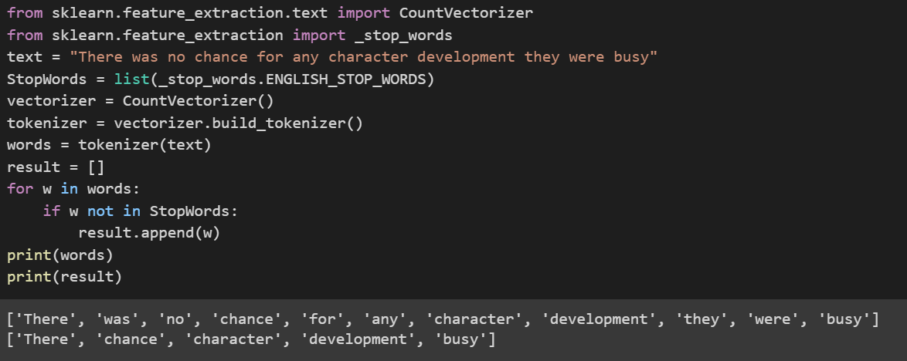
Removal of Stop Words
Load the stop words from feature_extraction module and store them
Generate tokenizer using build_tokenizer and tokenize data using the tokenizer
Loop words over stop words and remove them.

Slide 15
Stemming
Stemming is a text pre-processing technique which reduces a word to its stem or root format.
Stemming is done by maintaining a set of rules to the words and map them on to data.
Stemming algorithms are very simple and like search and replace operation.
Example : all the words ending with ‘ing’ and ‘ed’ suffixes can be dropped. This reduces the word mostly to their stem/root word, but in some cases it won’t.
Words that are derived from another word as their use in the speech changes are called Inflected words.
Various algorithms for stemming follow approaches such as
Listing all the inflected forms and looking up for best match in the stem words listing
Recognizing known prefix or suffix on known inflected forms and removing them to get the stem word.

Slide 16
Stemming
In Python stemming can be done using python nltk module (natural language tool kit)
There are two stemmers (stemming algorithms) available in nltk.
PorterStemmer
LancasterStemmer
Porter stemmer is older algorithm when compared with Lancaster and Lancaster stemmer is more aggressive compared to it.
Porter Stemmer uses suffix stripping and doesn’t follow linguistic rules, rather follows a set of 5 rules (steps) designed for various cases (step by step).

Slide 17
Stemming
Scikit Learn module doesn’t provide inbuilt functions for stemming, we can use Stemmers from nltk module and implement stemming in Scikit learn.
Import CountVectorizer class from scikit learn and any stemmer from nltk
Builder a callable function using build_analyzer() method of CountVectorizer
Develop a function which stems data and pass it as an argument(analyzer =) to CountVectorizer() constructor and fit the data to the Vectorizer
The function get_feature_names() will return the stemmed data list on vocabulary.

Slide 18
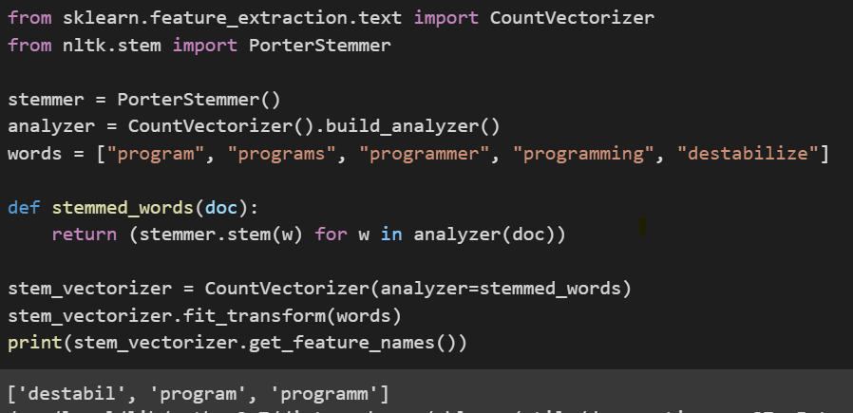
Stemming
Let’s use Porter Stemmer from nltk and CountVectorizer from sklearn to perform stemming. We will first create a callable function called analyzer and then define our stemming logic in a function and pass analyzer parameter as shown. We can see that the words “Program” and “programs” have been stemmed as “program”, “programmer” and “programming” as “programm” and destabilize as “destabil”.

Slide 19
Parsing HTML Documents
There are many tools for web scraping and obtaining HTML data for webpages in HTML format. Python provides libraries such as urllib and scrapyd for web scraping.
Once we have HTML data, the next task is to parse the HTML data as textual data.
As we know HTML pages contain data in form of tags. Hence we have to parse data from HTML format to extract textual data by removing tags and other HTML components.
Python provides libraries such as bolierpy3 and BeautifulSoap to parse textual data from HTML pages. By using these libraries for parsing we get textual data from HTML pages .

Slide 20
Cleaning HTML Documents
Sentence = ‘It is raining heavily outside’
Trigrams = [‘It is raining’ , ‘is raining heavily’ , ‘raining heavily outside’]
By searching for large n-grams that occur frequently, we are able to detect the repeated elements across websites in our corpus, and manually filter them out.
We can work on N-grams using CountVectorizer instance with ngram_range parameter.
ngram_range : tuple (min_n, max_n), default=(1, 1)
The lower and upper boundary of the range of n-values for different word n-grams or char n-grams to be extracted. For example a ngram_range of (1, 1) means only unigrams, (1, 2) means unigrams and bigrams, and (2, 2) means only bigrams
Vectorizer = CountVectorizer(ngram_range = (2,2))
Vectorizer.fit_transform(data)

Slide 21
Feature Extraction
Feature extraction is a trivial step in the NLP workflow
It is done for a better understanding of context of what data we are dealing with.
After cleaning and normalization of data, it is transformed into features for modelling
We use feature extraction methods to assign weights to particular words within our data or text before modelling. Computers or machine learning algorithms process on numbers.
Hence, we go for numerical representations of words in data or vectorization of data.

Slide 22
Feature Extraction
Storing the counts of words etc. methods can be applied, and text can be converted into numbers or vectors of numbers for machine learning model.
The basic requirements for vectorizing the sentence could be
It should not result in a sparse matrix since sparse matrices result in high computation cost
We should be able to retain most of the linguistic information present in the sentence
There are many such techniques for vectorizing the text into numbers
Bag of Words model
TF-IDF
One hot encoding

Slide 23
Bag of Words
Bag of words is a simple and most used model for extracting features from text and using them in building models.
Bag of words approach is simple and flexible and easy for any one to use
It is a technique which extracts features as representation of text based on the occurrences of words within the text.
This method involves two major things:
Vocabulary of known words
Measure of the presence of known words

Slide 24
Bag of Words
Bag of words model basically consists of 3 major steps
Collect data
Design the Vocabulary
Create vectors
Let’s investigate each of the steps in detail by taking an example
Collect Data:
Let’s take a sample of data from movie reviews.
This movie is very scary and long
This movie is not scary and is slow
This movie is spooky and good

Slide 25
Bag of Words
Design Vocabulary:
Now we make list of all the unique words present.
We ignore the order and case of the words (all the words are converted into lower case)
The list of unique words in our use case forming vocabulary.
Vocabulary consists of words: “this”, “movie”, “is”, “very”, “scary”, “and”, “long”, “not” , “slow”, “spooky”, “good”.
Hence the vocabulary now consists of 11 unique words
These 11 unique words form the sentences in the data corpus which we are using

Slide 26
Bag of Words
Creation of vectors:
The objective of vectorization is to convert the text into vectors of numbers that we can use as input or output for any machine learning model.
We now have 11 words in the vocabulary. Hence, the length of each vector to represent each word occurrence will be 11.
The simplest way of scoring the occurrence of word in the vector is by a Boolean value. A value of 1 represents the word is present and 0 represents its absence.
Using the arbitrary order mentioned above in the vocabulary let’s make a binary vector for text

Slide 27
Bag of Words – Scikit-Learn
Scikit Learn provides CountVectorizer class to implement bag of words model directly. CountVectorizer class is present in sklearn.feature_extraction.text module
Bag of words can be implemented using CountVectorizer class as follows
Create an instance of CountVectorizer class
Call the fit() function to create vocabulary of the data
Call the transform() function to generate vectors for the data
Fit_transform() method can be used instead of steps 2 and 3.

Slide 28
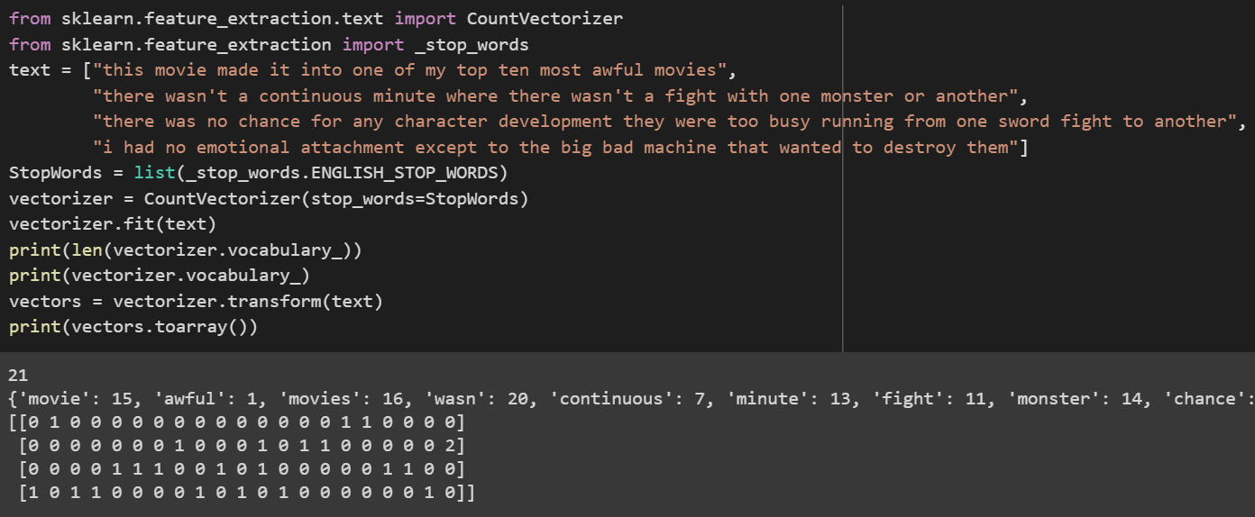
Bag of Words – Scikit-Learn

Slide 29
Bag of Words – Scikit-Learn
CountVectorizer has an attribute called stop_words, which is used to remove stop words while creation of vocabulary using the vectorizer.
The parameter vocabulary_ can be used to get the vocabulary generated by the vectorizer and stop_words_ is used to get the stop words ignored.
As we can see the vocabulary consists of 21 words and hence an array of shape (4,21) is returned which specifies the vector representations of the text.
The scoring method used here is count, hence the vector stores the occurrences of words in the vocabulary in the vectors.

Slide 30
TF - IDF
In Bag of words approach each word is treated equally, but in a document there is a high chance that a particular word repeats more often than others.
TF – IDF stands for Term Frequency – Inverse Document Frequency
TF - IDF works with assigning weights according to importance.
If we take each sentence as a document and counting the number of documents each time a word occurs, it is called document frequency. Term frequency is the frequency of occurrence of word. We then divide TF by IDF to get TF-IDF

Slide 31
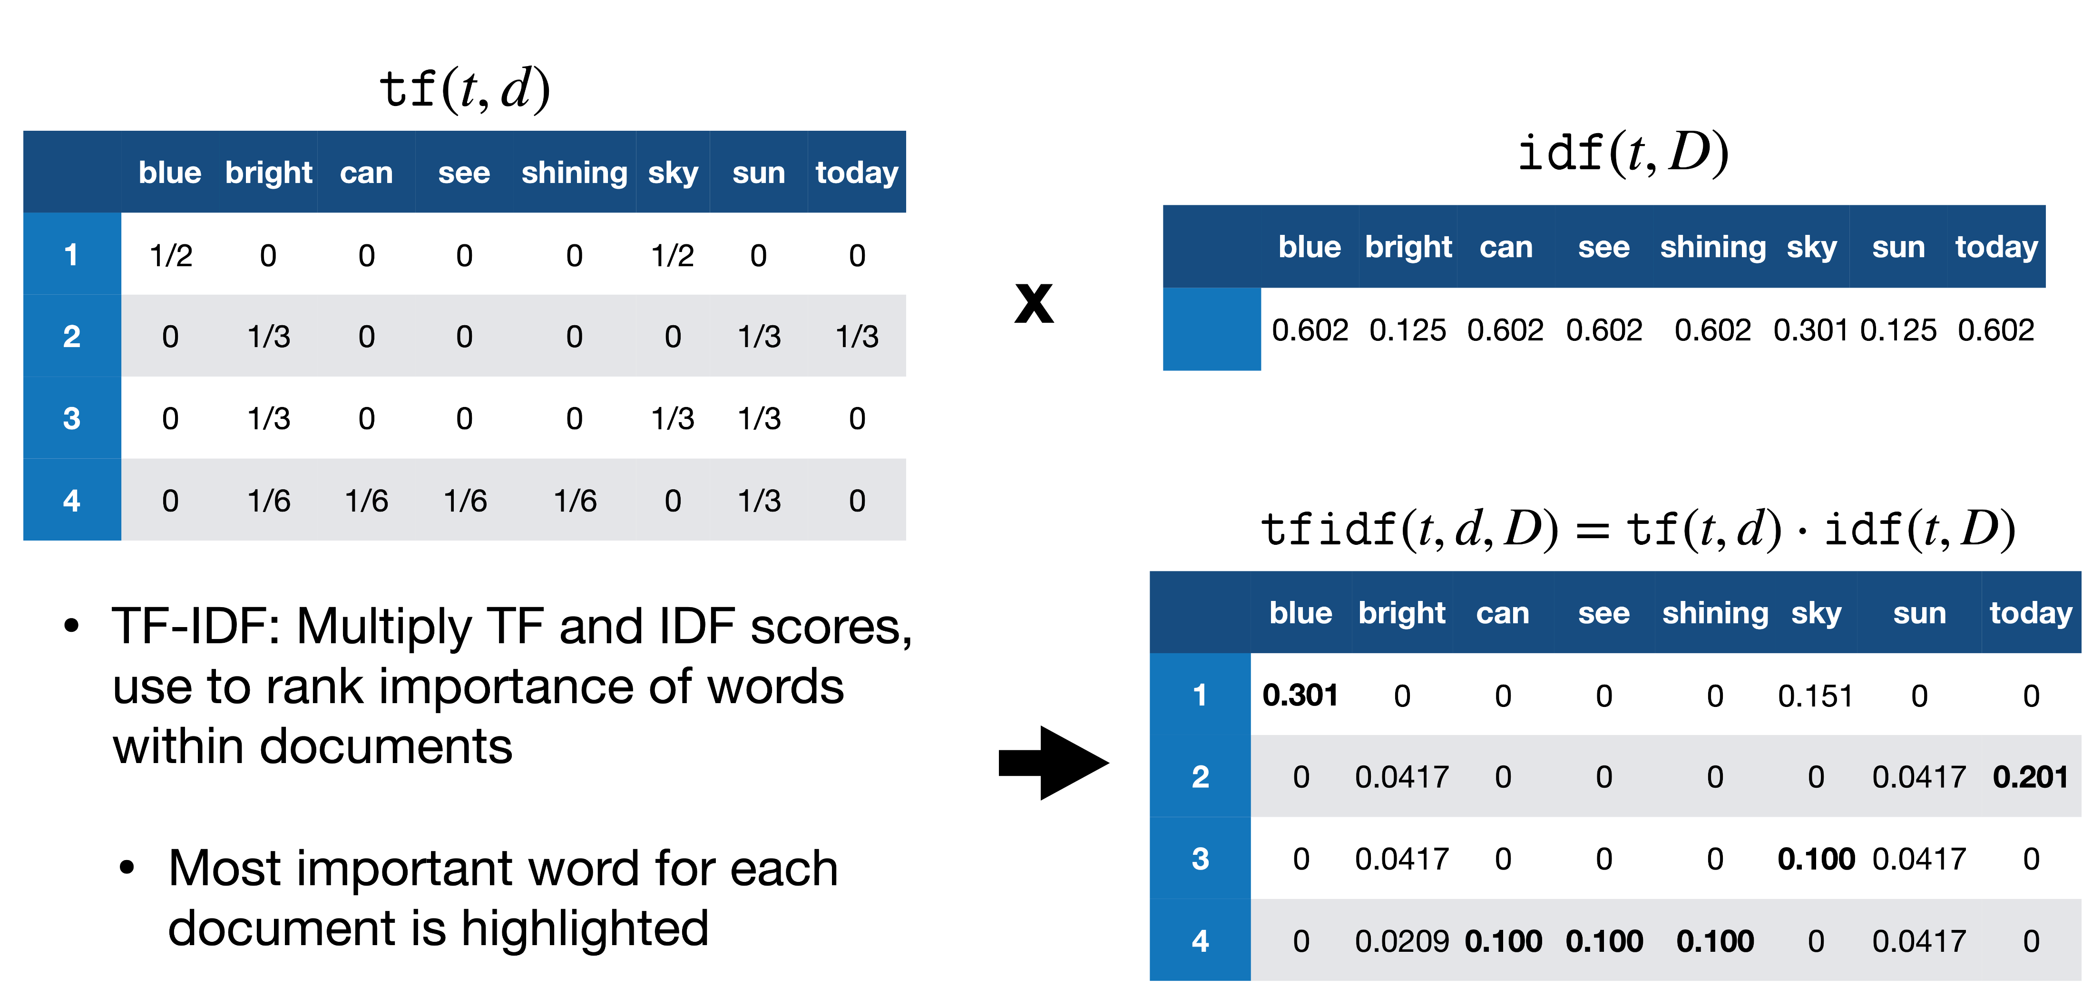
TF - IDF
Source : analyticsvidhya

Slide 32
TF - IDF
Term Frequency: is a scoring of the frequency of the word in the current document.
Inverse Document Frequency: is a scoring of how rare the word is across documents.
Term frequency can be calculated as number of occurrences of a word in a sentence divided by total number of words in a sentence
Inverse document frequency can be calculated as logarithm of number of sentences divided by number of sentences containing that words.
TF-IDF = TF * IDF

Slide 33
TF – IDF in python
TF – IDF values can be computed in python using TfidfVectorizer() method in sklearn module.
Syntax (Reference) : sklearn.feature_extraction.text.TfidfVectorizer(input)
Parameters:
input: It refers to parameter document passed, it can be be a filename, file or content itself.
Attributes:
vocabulary_: It returns a dictionary of terms as keys and values as feature indices.
idf_: It returns the inverse document frequency vector of the document passed as a parameter.
Returns:
fit_transform(): It returns an array of terms along with tf-idf values.
get_feature_names(): It returns a list of feature names.

Slide 34
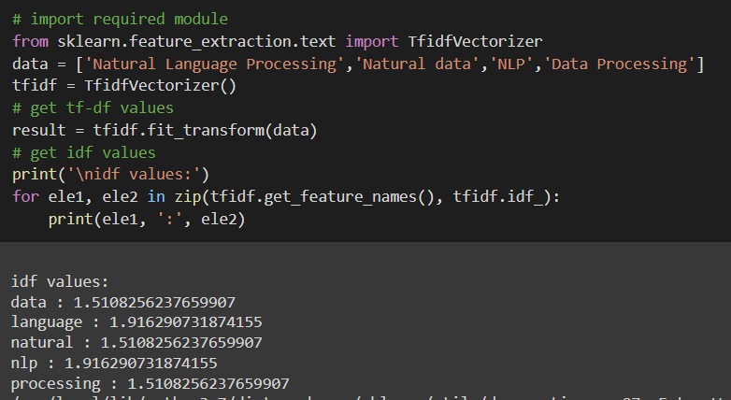
TF – IDF in python
TfidfVectorizer class instance is created as tfidf and fit_transform method is applied on data to get the tf-idf values of data.

Slide 35
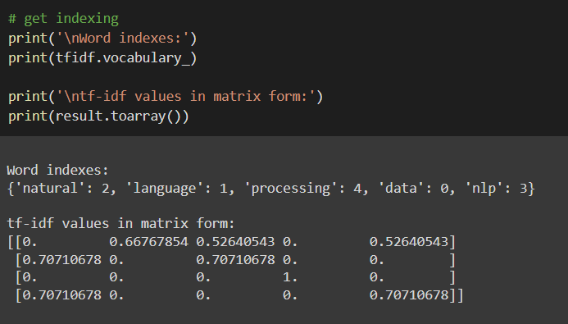
TF – IDF in python
Tfidf.vocabulary_ parameter gives the vocabulary names and the indices assigned to the names.
We can see the vectors built using tf-idf model.

Slide 36
Assignment on Textual data Handling
Sample of text we are processing:
This movie made it into one of my top 10 most awful movies. Horrible. There wasn't a continuous minute where there wasn't a fight with one monster or another. There was no chance for any character development, they were too busy running from one sword fight to another. I had no emotional attachment ( except to the big bad machine ## that wanted to destroy them).
Write python code to clean the above text using the textual data cleaning methods discussed earlier and implement all the strategies as functions.
Using the functions created for cleaning generate summary of the above data by applying TF/IDF scoring.

Slide 37
Summary

Slide 38
Q&A

